Slide 1



DOCTO
Patient-centered information exchange system
TEAM: GEEK HUB
THEME: HEALTHTECH
A token of health for everyone

Slide 2





“In the current situation of COVID-19, all the essential services including healthcare have become difficult to be physically accessed, pertaining to the need of social distancing and high risk of virus transmission in public areas such as a hospital or a health-care center.
Thus, in order to preliminarily self-diagnose the diseases using AI enabled software and furthermore ease the process of consulting a doctor, we have developed a mobile application named Docto.”
Motivation
.

Slide 3



Salient Features
An interactive chatbot with an appealing UI for easing children to list their symptoms and get a recommendation.
Specialized consultations and diagnosis available for children, adult and elderly people.
For adults, an AI enabled X-Ray based COVID-19 diagnosis tool which also serves as an aid to the doctors.
For elderly, an AI based Parkinson’s disease diagnosis tool, using two independent tests which require only a paper and a pencil, and an AI aided blind vision assistance tool.
Additionally, the application can directly measure the pulse rate of an individual using the method of PPG using the phone camera, without any additional hardware.

Slide 4

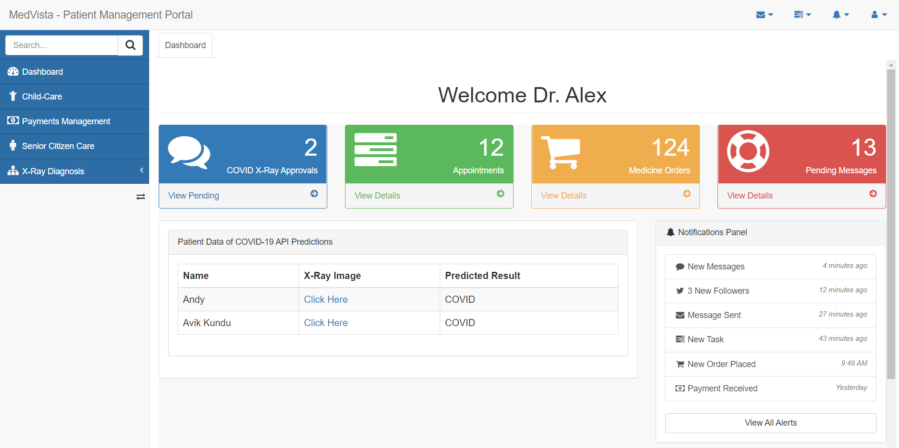




Technology Stacks and Tools Used
Android Application written in Kotlin
A MERN Stack Web Application
Deep Learning Models for Chest X-Ray, Parkinson Syndrome and Image Captioning in Keras/Tensorflow
Containerizing the Application using Docker for safe and secure deployment on Cloud Engines.

Slide 5


Child Care : This section has a chatbot interface for small children as they are reluctant to go to a doctor. The user is supposed to answer an assorted list of questions related to their prognosis through the interface and based on their answers, a preliminary diagnosis is made along with further instructions for immediate care. The user also has the option to book an appointment or search for the nearby doctors.
Adult Care : Automated COVID-19 Prediction : This feature in the mobile application allows patients to undergo a self-diagnosis for COVID-19 by uploading images of chest X-ray scans. The results of the diagnosis is immediately shared both to the patients as well as their appointed doctors on the MedVista Platform. The diagnosis is done using a deep learning algorithm, which has been found to be have high sensitivity and specificity and has been verified by experts.
DOCTO
Android Application

Slide 6

Senior Citizens Care
Automated Detection of Parkinson's Disease
Image Captioning/
Blind Vision Assistance
Heart-Rate Sensor
This feature has been implemented for patients who have an history of slow movement, stiffness and loss of balance.
They can check whether they are suffering for Parkinson's Disease by performing the Spiral Test, where the patient is required to draw a spiral using a pencil on a blank sheet of paper and upload the image of the spiral.
The machine learning algorithm diagnoses for the presence of the disease based on the characteristics of the uploaded image.
This feature has been specially developed and implemented for visually impaired patients or the patients who are suffering from any eye ailments to assist them by making them aware of their immediate surroundings.
The patients are supposed to click an image of their surroundings with the smartphone camera, following which a deep learning model will describe the activity taking place in the image.
A pretrained CNN model extracts the features from the input image. The feature vector is linearly transformed to have the same dimension as the input dimension of the RNN/LSTM network.
This network is trained as a language model on our feature vector to produce the image description.
This feature enables patients to use their Android Devices as an instrument for real-time heart rate measurement based on photoplethysmography (PPG).
It is one of the most unique and highly accurate technology, which requires just a smartphone camera with flash. The user is supposed to place their finger upon the camera and flashlight of their smartphone.
Following this, PPG can detect the heart rate, where the light illuminated on the finger gets absorbed by the blood inside the capillaries of the finger, the volume of which changes with every heartbeat.

Slide 7
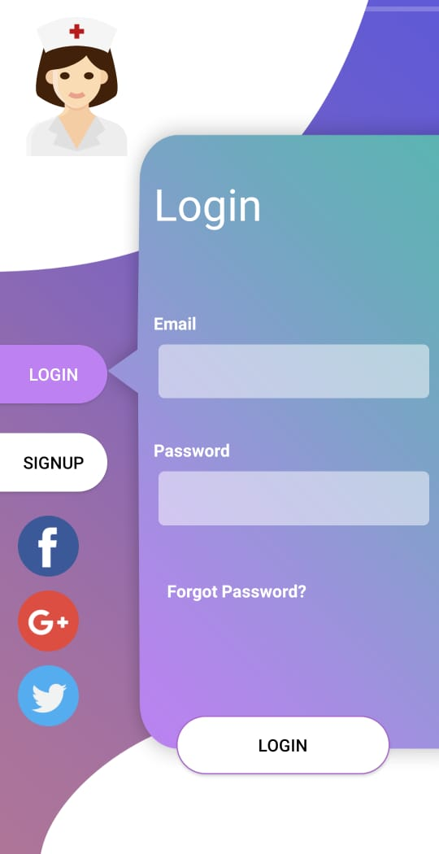
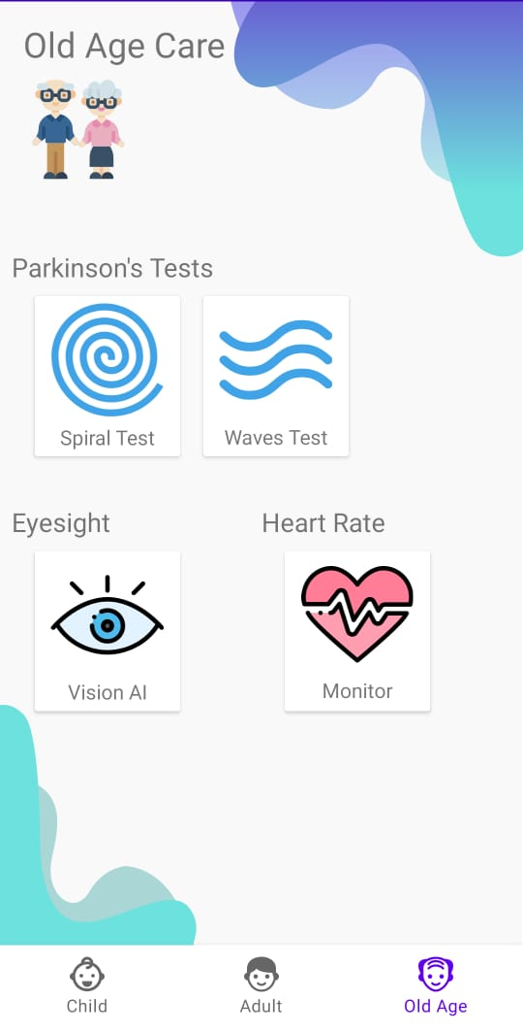
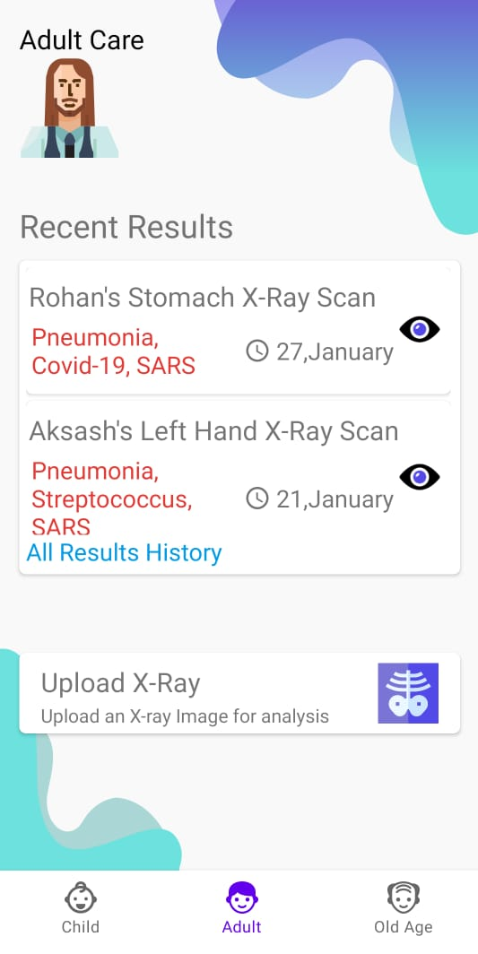
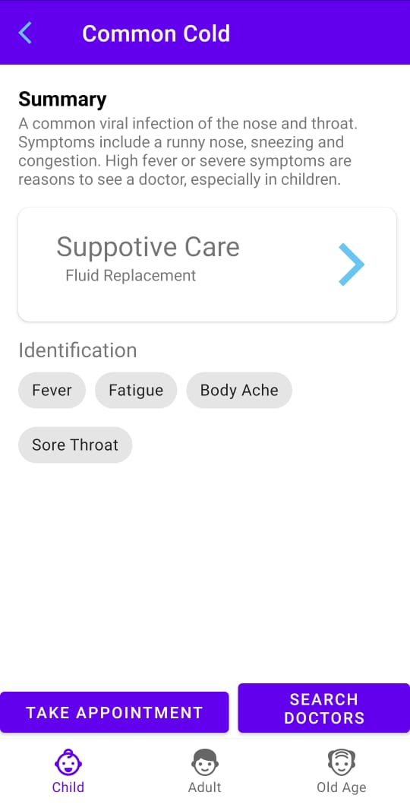


ANDROID APP
https://tinyurl.com/doctoapp

Slide 8

MedVista
Web
Application Platform
An Integrated Medical Platform tailored for the specific needs of the Doctors.
Through this platform, they can efficiently access their patient information in real-time.
Easy to track Appointments, Payments and Review Reports.
Thus, Doctors can focus more on their job.
https://medvista.herokuapp.com

Slide 9

MEDVISTA

Slide 10




1
Preliminary cost to be incurred in hosting the application backend and database storage in AWS cloud and publishing the application in Google Play Store.
Business and Social Aspects
Publicly available free android application with minimal personal user data retention in secure cloud database as well as secure login and signup to ensure strict user data privacy and authorisation, respectively.
2
An essential aid for tackling healthcare challenges due to COVID-19 for both the patients and the doctors by ensuring easy virtual doctor appointment booking and contactless self-diagnosis using AI, reducing the risk of infection.
3
Further iterations of the prototype will include a dedicated interface for facilitating online consultation with the doctor along with the interface to book appointment with a doctor. Several other AI enabled self-diagnostic tests such as skin cancer diagnosis will be integrated to assist the doctor with the proper diagnosis.
4

Slide 11


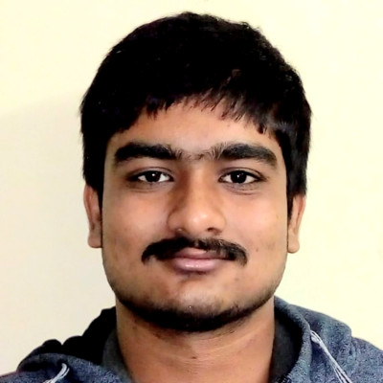


Avik Kundu
Web Developer | DevOps & Cloud
Meet The Team:
“Life is not a problem to be solved, but a reality to be experienced.”
Meghdut Mandal
Android Developer | AWS
Neelanjan Manna
Data Science, Machine Learning, Deep Learning, and Computer Vision

Slide 12

THANK YOU!
TEAM: GEEK HUB
THEME: HEALTHTECH

